Slide 1
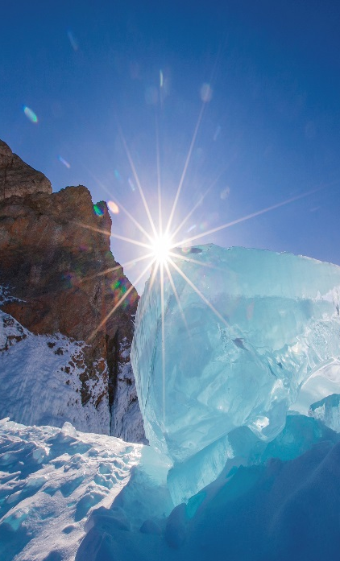
IR/WA Luncheon Presentation
Interior Energy Project Update
February 22, 2017

Slide 2
Presentation Summary
Memorandum of Understanding
Next Steps
2

Slide 3
Utility Integration
Memorandum of Understanding
for
Pentex Acquisition and IEP Financing
3

Slide 4
IEP PURPOSE AND GOALS
“. . . to bring low-cost energy to as many residents and businesses of Interior Alaska as possible, as quickly as possible . . “
Improve air quality within the FNSB non-attainment area
4

Slide 5
Definitions
Titan LNG plants
  Titan 1 Current LNG plant providing FNG with approximately 1B* in LNG
  Titan 2 New LNG plant, integrated into Titan 1 that will provide 3B in LNG
  Titan 3 Expansion of the LNG plant (Titan 1 & 2) to meet increased demand as demand materialize. Will provide additional 3B in LNG
Distribution System by Phase
  IGU
  1 Customer service lines and meters for the 73 miles of gas mains installed in 2015
  2 Install 68 miles of gas mains along with customer service lines and meters
  3 Install 128 miles of gas mains along with customer service lines and meters
  FNG
  Customer service lines and meters for the existing 134 miles of gas mains and expansion of up to 40 miles of gas main.
Storage
  5.2 Million gallons of storage located in Fairbanks
  Two 75,000 gallon tanks located in North Pole
*1B = 1 billion ft³ of liquid natural gas = approx. 7.46 Million Gallons of fuel oil
5

Slide 6
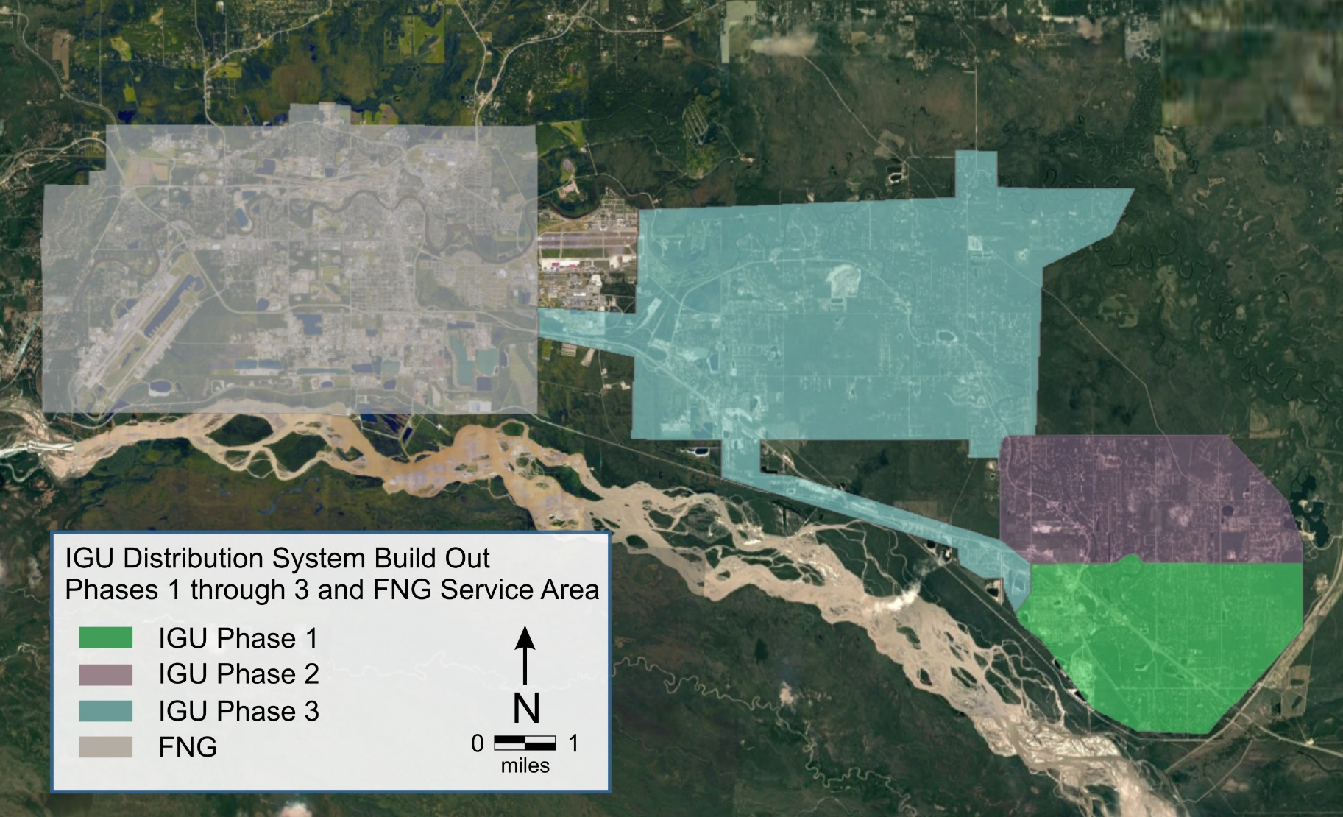
IGU CAPITAL PLAN – 2017 thru 2022
Note: Service lines, meters and Conversion Program will be ongoing
6
Notes:
ADD FNG AREA, DROP SIZES OF PIPES, CUSTOMERS WILL NOT CARE

Slide 7
AIR QUALITY 2013-2014 SEASONS
7
Notes:
REMOVE BLACK LINES - TRY AND SHOW PHASES 1-3 INSTEAD

Slide 8
By the Numbers
Customers* Existing FNG FNG Buildout IGU Buildout | 8,840 1,140 4,000 3,700
Demand (BCF) | 5.3
LNG Deliverability (BCF) | 5.4
LNG Plant Capacity (BCF) | 7.5
Estimated Gas Cost ($ / MCF) ** | 15.50
Revenue/Yr ($M) | 88
Capital Plan ($M) | 333
Air Quality Improvement *** Fairbanks/FNG (%) North Pole/IGU (%) | 8.6 26.4
* Conversions based on Cardno Report, Sensitivity Analysis 2015
** Includes a volumetric charge of $15 / MCF and a customer charge
*** “Order of Magnitude” Preliminary AQ Improvement forecast – Sierra Research
8
Notes:
ADD 15.50 MCF TO THIS SOMEWHERE

Slide 9
Utility Integration MOU (1 of 2)
SCOPE (CREATES FULLY INTEGRATED FNSB NATURAL GAS UTILITY)
Titan 1 upgrades, Titan 2 and Titan 3 - construction
Fairbanks LNG Storage - 5.2 million Gallons - construction
North Pole LNG Storage – 150,000 Gallons - construction
Full build-out of IGU Phases 1-3 Distribution System & FNG Expansion Area
Services and Meters
Customer Conversion Program
9

Slide 10
Utility Integration MOU (2 of 2)
Establishes Key Business & Financial Terms
Overall financing plan
  Commitment of $330M in total to IGU’s development & startup
  Structure of $125M SETS Loans
  Standards and process for issuance of $150M of AIDEA bonds for IGU capital program
IGU purchase of Pentex (including Titan, FNG, all Pentex assets)
Process and timing of system integration
Contingent upon
  Economically sufficient Gas Supply Contract
  Due Diligence
10

Slide 11
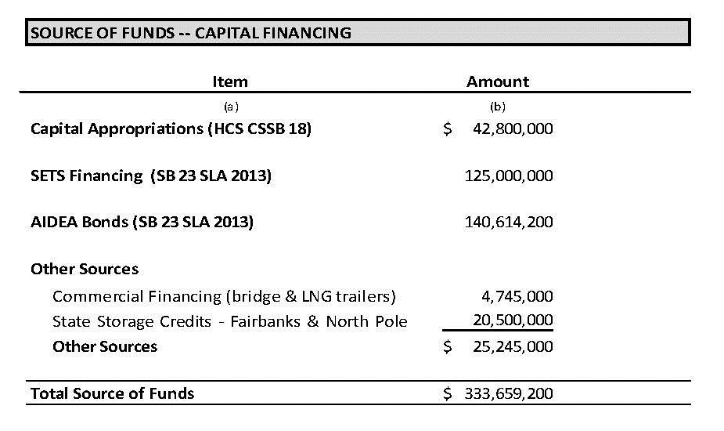
Financials – Fund Sources
11

Slide 12
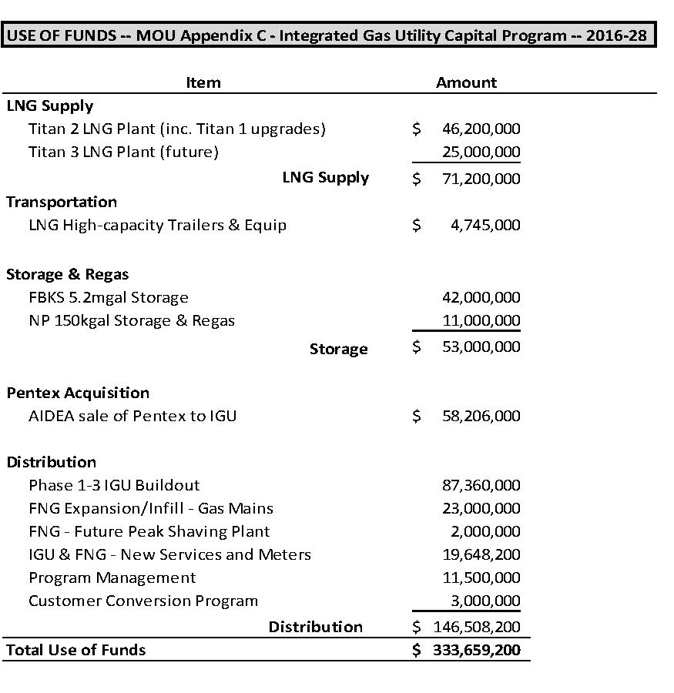
Financials –Use of Funds
12

Slide 13
SETS Financing Terms
SETS financing flexibility includes:
  15 Year Deferment
  0.25% Interest Rate
  50-year payback term *
  SETS repayment is in a secondary position to AIDEA Bonds
  Summary of SETS Loan Terms
Item | Deferment | Repayment Term | Total Loan Term | Interest Rate | Annual Debt Service
SETS Loan Terms | 15 yrs | 35 yrs | 50 yrs | 0.25% | $3.73 m

Slide 14
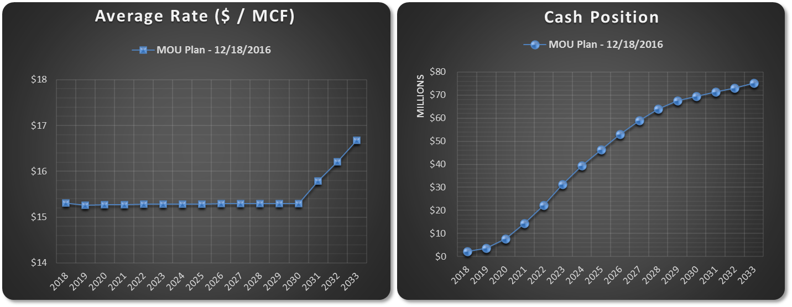
MOU Plan – Average Rate and Cash Position
Proposed MOU (12/16/2016):
High probability of meeting goal of $15 per MCF rate for a 10-year period
Generates cash reserves for stronger financial position and future buildout of Phases 4-6
14

Slide 15
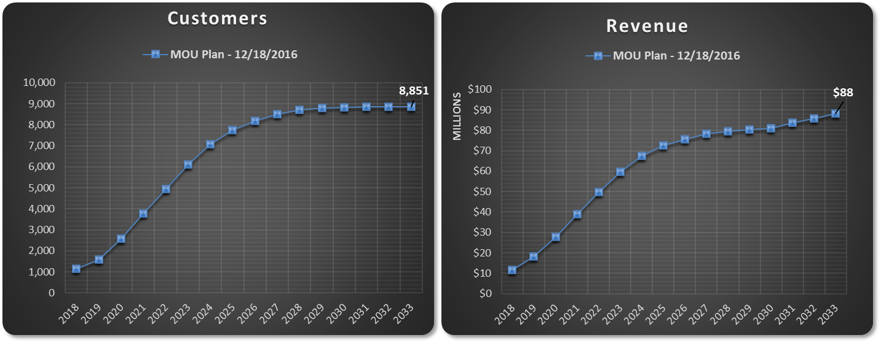
MOU Plan – Customers and Revenue
Proposed MOU (12/16/2016):
Provides natural gas service to 8,850 customers in Fairbanks/North Pole area
Expected revenues are sufficient to cover operating costs and debt service while generating margins for future build-out
15

Slide 16
Next Steps

Slide 17
NEXT STEPS (SHORT TERM)
Drafting of executable Pentex Purchase / IEP Financing Agreements (initiated - to be completed by March 31)
Due Diligence and Utility Integration Planning (ongoing)
Gas Supply contract (ongoing)
Immediate Capital Programming
LNG Plant Facility Front End Engineering & Design (FEED)
LNG Storage Development in FNSB
AIDEA certification of “HB 105 Plan”
RCA Approval of Ownership Transfer
Execution of MOU-related Agreements
IGU / FNG Integration
17

Slide 18
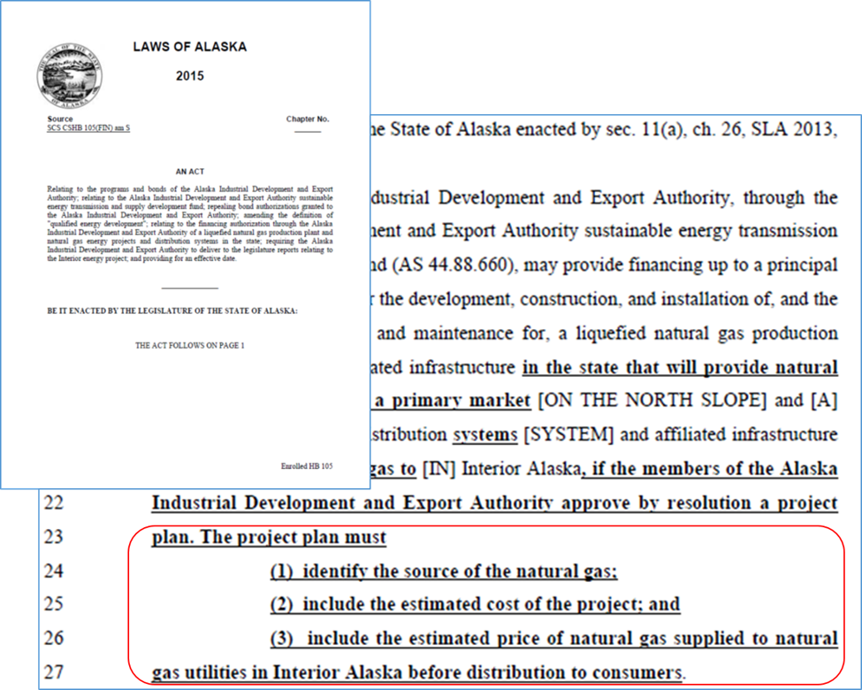
Look Forward: “HB 105 Compliant Plan”
AIDEA Resolution Required to allow expenditure of further IEP Funds
HB 105 requires a project plan within the AIDEA Board Resolution to include:
Source of natural gas
Estimated total project cost
Estimated “pre-distribution” cost of supplied gas
18

Slide 19
Next Steps (LONGER TERM)
Conversion program
Storage tanks constructed
  LNG storage reimbursement
LNG plants constructed
Finalize transportation plan
Distribution system expansion planning and construction
19

Slide 20
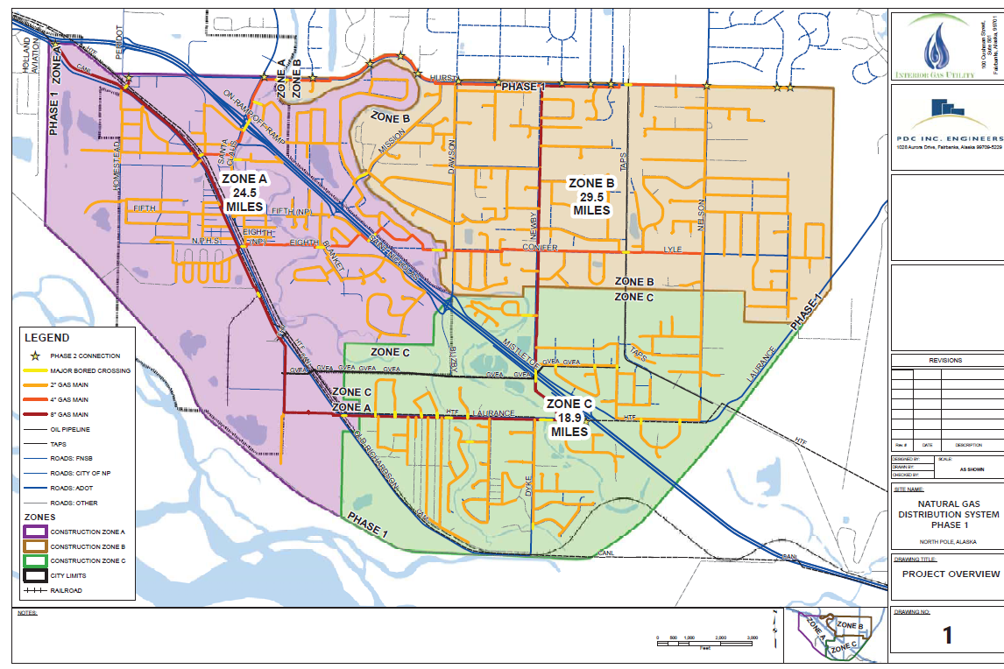
IGU Phase 1 – 2015
20
Notes:
ADD FNG AREA, DROP SIZES OF PIPES, CUSTOMERS WILL NOT CARE

Slide 21
BUILDOUT FORECAST
Task | 2017 |  |  |  | 2018 |  |  |  | 2019 |  |  |  | 2020 |  |  |  | 2021 |  |  |  | 2022
 | Q1 | Q2 | Q3 | Q4 | Q1 | Q2 | Q3 | Q4 | Q1 | Q2 | Q3 | Q4 | Q1 | Q2 | Q3 | Q4 | Q1 | Q2 | Q3 | Q4 | Q1 | Q2 | Q3 | Q4
Pentex Aquisition
LNG Supply
Titan 2
Titan 1 Upgrades
Titan 3
Transporation
Storage and Vaporiztion
FBKS 5.2mgal Storage
NP 150kgal Storage
Distribution
Phase 2 IGU Buildout
Phase 3 IGU Buildout
FNG Expansion - Gas Mains
IGU & FNG - New Services/Meters
Customer Conversion Program
Updated 01-3-2017
21

Slide 22

Questions
22

